Slide 1
Naïve Bayes

Slide 2
Reading Assignment
Wikipedia article on Naive Bayes classifier

Slide 3
What is Naïve Bayes Algorithm
It is a classification technique based on Bayes’ Theorem with an assumption of independence among predictors.
In simple terms, a Naive Bayes classifier assumes that the presence of a particular feature in a class is unrelated to the presence of any other feature.
For example, a fruit may be considered to be an apple if it is red, round, and about 3 inches in diameter. Even if these features depend on each other or upon the existence of the other features, all of these properties independently contribute to the probability that this fruit is an apple and that is why it is known as ‘Naive’.

Slide 4
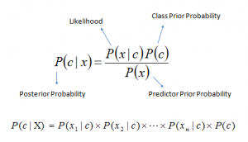
Bayes Theorem
Bayes theorem provides a way of calculating posterior probability P(c|x) from P(c), P(x) and P(x|c). Look at the equation below:
P(c|x) is the posterior probability of class (c, target) given predictor (x, attributes).
P(c) is the prior probability of class.
P(x|c) is the likelihood which is the probability of predictor given class.
P(x) is the prior probability of predictor

Slide 5
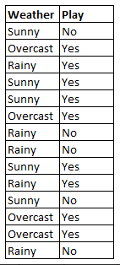
How Naïve Bayes Algorithm works?
Let’s understand it using an example. Below I have a training data set of weather and corresponding target variable ‘Play’ (suggesting possibilities of playing).

Slide 6
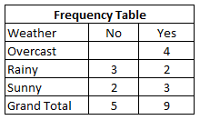
How Naïve Bayes Algorithm works?
Now, we need to classify whether players will play or not based on weather condition. Let’s follow the below steps to perform it
Step 1: Convert the data set into a frequency table

Slide 7
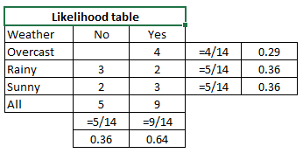
How Naïve Bayes Algorithm works?
Step 2: Create Likelihood table by finding the probabilities like Overcast probability = 0.29 and probability of playing is 0.64.
Step 3: Now, use Naive Bayesian equation to calculate the posterior probability for each class. The class with the highest posterior probability is the outcome of prediction.

Slide 8
How Naïve Bayes Algorithm works?
Problem: Players will play if weather is sunny. Is this statement is correct?
We can solve it using above discussed method of posterior probability.
P(Yes | Sunny) = P( Sunny | Yes) * P(Yes) / P (Sunny)
Here we have P (Sunny |Yes) = 3/9 = 0.33, P(Sunny) = 5/14 = 0.36, P( Yes)= 9/14 = 0.64
Now, P (Yes | Sunny) = 0.33 * 0.64 / 0.36 = 0.60, which has higher probability.
Naive Bayes uses a similar method to predict the probability of different class based on various attributes. This algorithm is mostly used in text classification and with problems having multiple classes.

Slide 9
Let’s get into action with python, see you in next lecture!

